Slide 1
Implementing Domain Driven Design (DDD)
A practical guide to implement DDD building blocks

Slide 2
Overview
Part-I: What is DDD? Why and where we should use it?
Part-II: DDD
Architecture & Layers
Execution Flow
Building Blocks
Common Rules
Part-III: Implementation
Layering a Visual Studio Solution
Building Blocks: Key rules & samples

Slide 3
Part-I: What is DDD?
Why and where we should use it?

Slide 4
TODO..!

Slide 5
Part-III: DDD
DDD Architecture & Building Blocks

Slide 6
TODO..!

Slide 7
Part-III: Implementation
Implementing Domain Driven Design (DDD)

Slide 8
Aggregate Roots Principles
Should maintain self integrity & validity
Implements domain rules
Saved & retrieved as a single unit (with sub-collections)

Slide 9
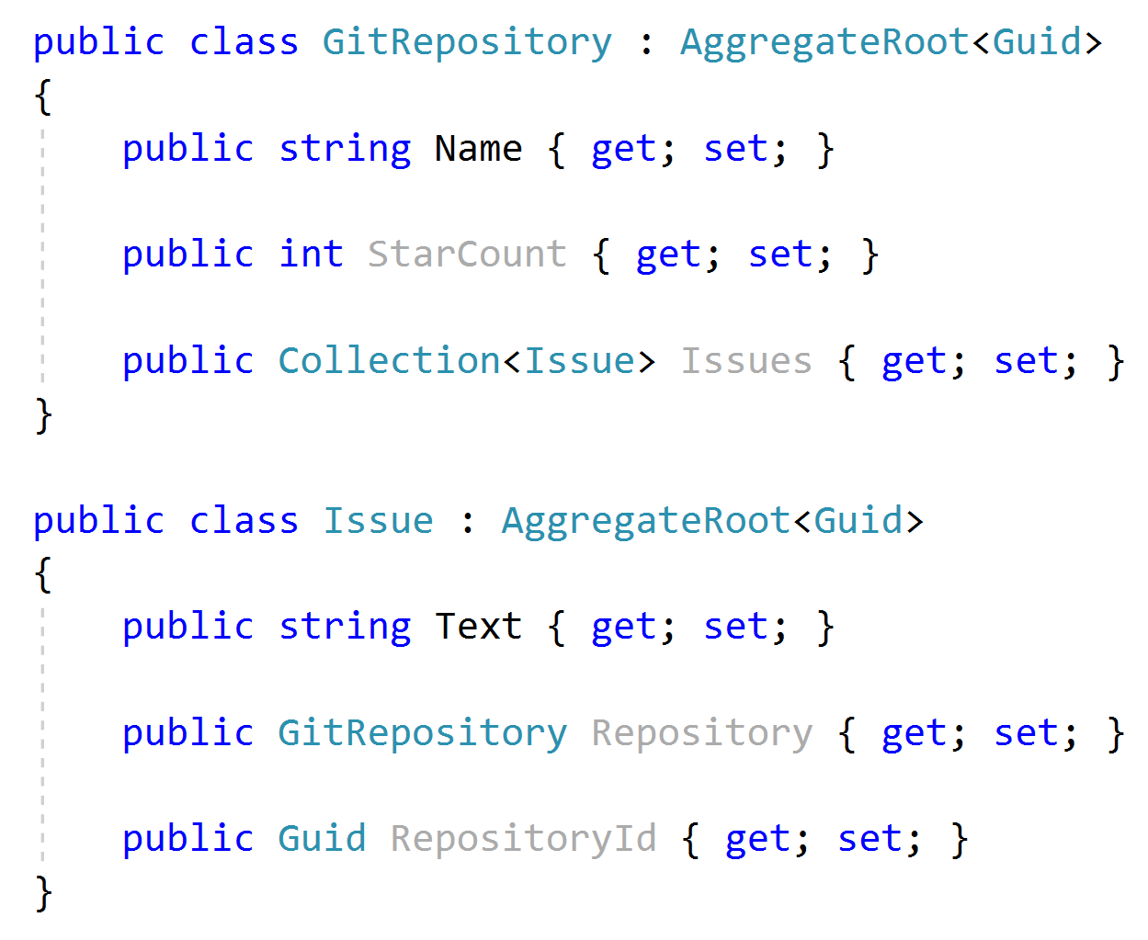


Aggregate Roots Rule: Reference other aggregates by Id

Slide 10
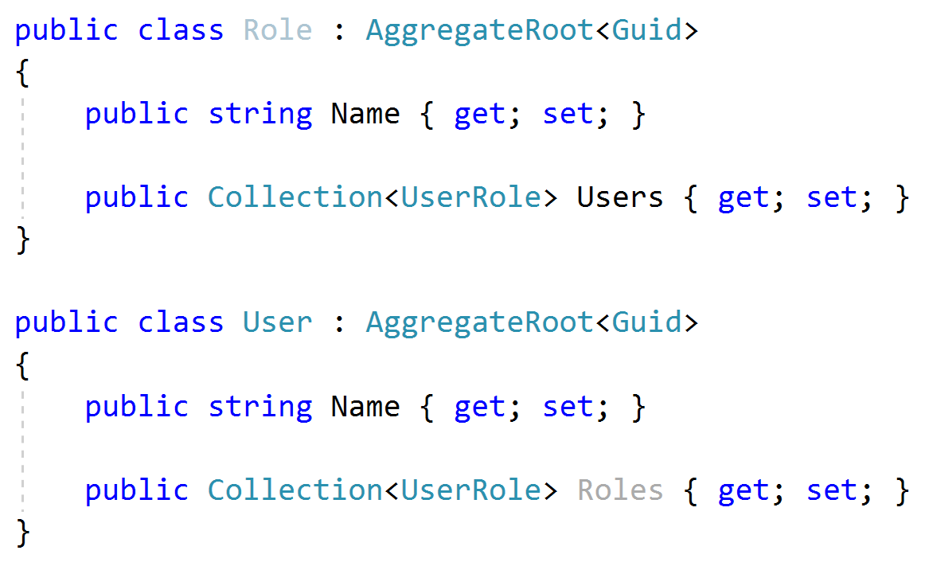
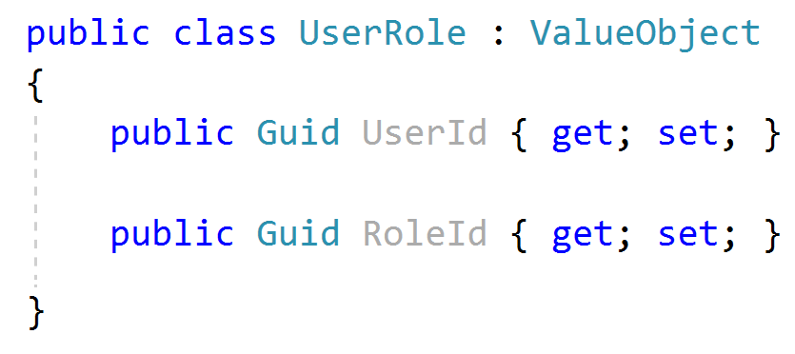
Aggregate Roots Tip: Keep it small
Considerations;
Query Performance
Data Integrity & Validity
Should be serializable (required for NoSQL databases)

Slide 11
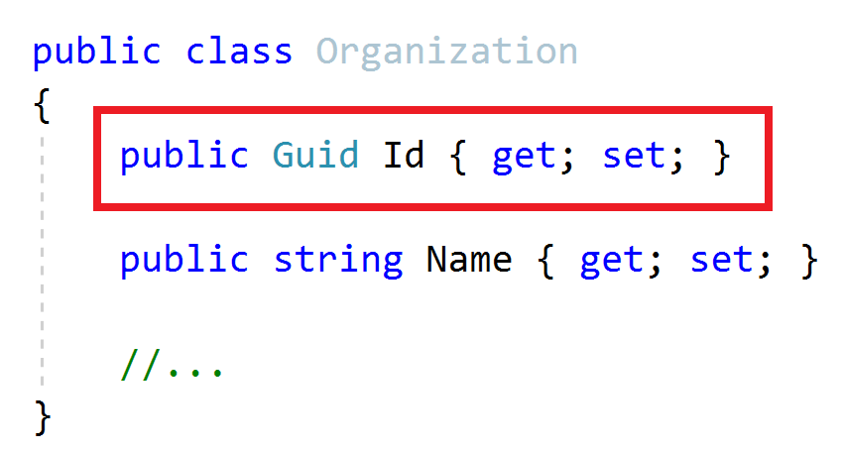
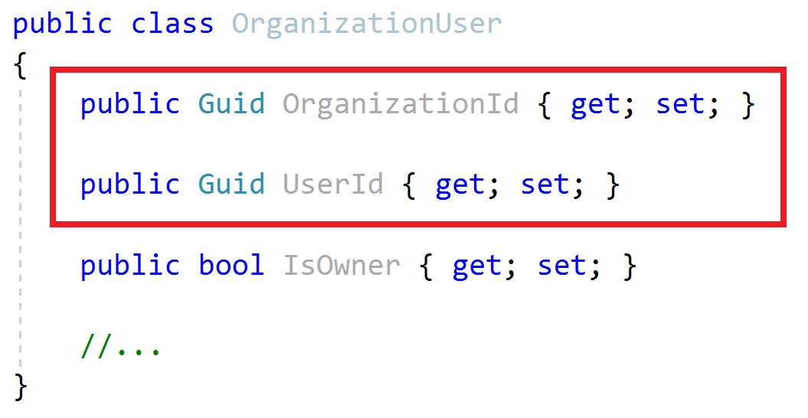
Aggregate Roots / Entities Primary Keys
Aggregate Root
Entity
Define a single Primary Key (Id)
Define a composite Primary Key
Suggestion: Prefer GUID as the PK

Slide 12
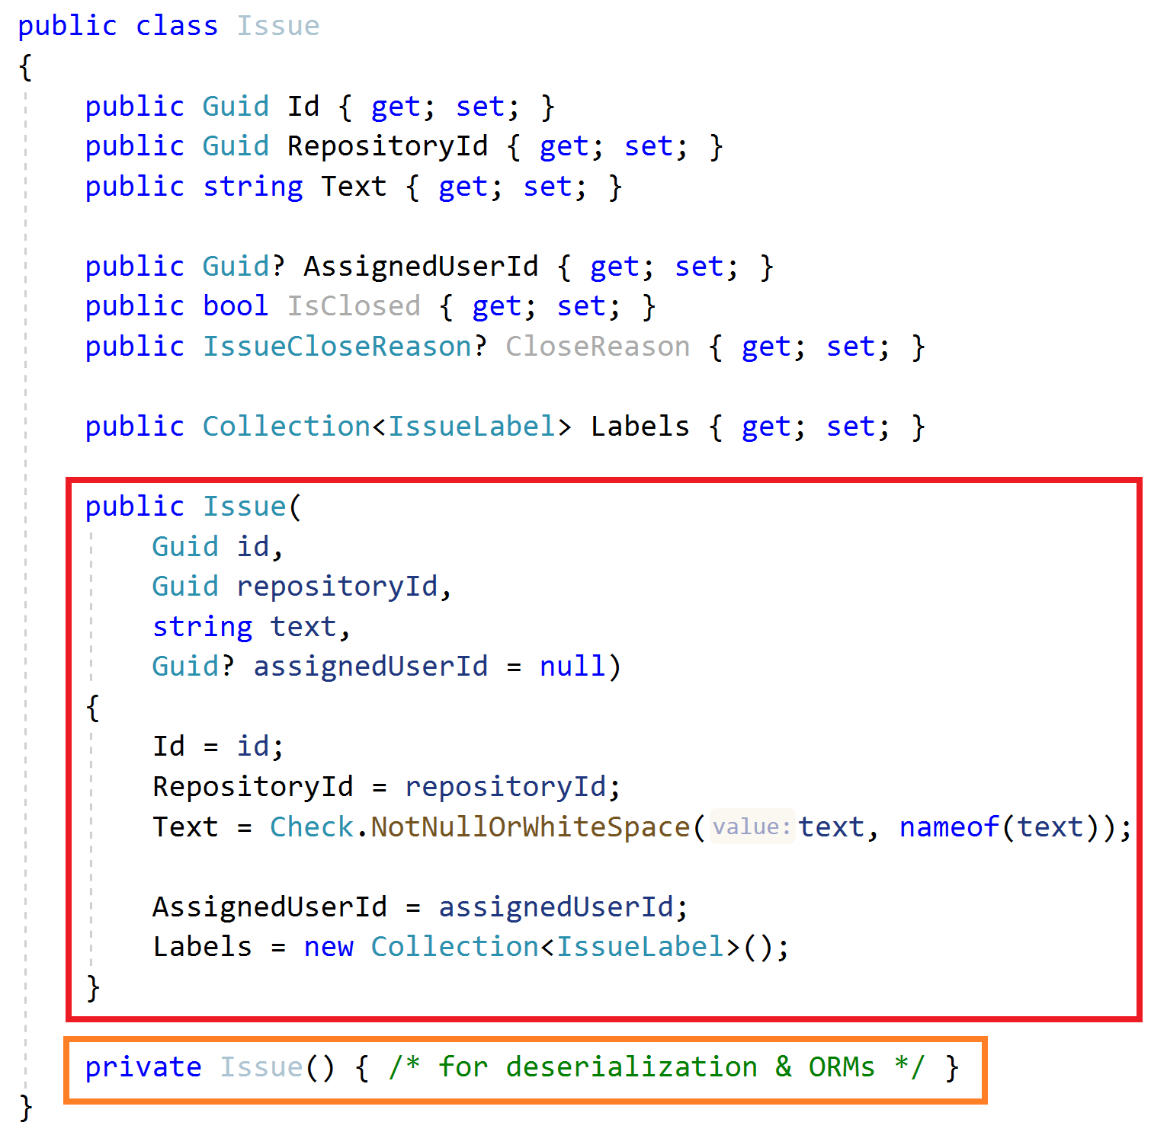
Aggregate Roots / Entities Constructor
Force to create a VALID entity
Get minimum required arguments
Initialize sub collections
Get id as an argument (don’t use Guid.NewGuid())
Use a service to create GUIDs, like IGuidGenerator

Slide 13
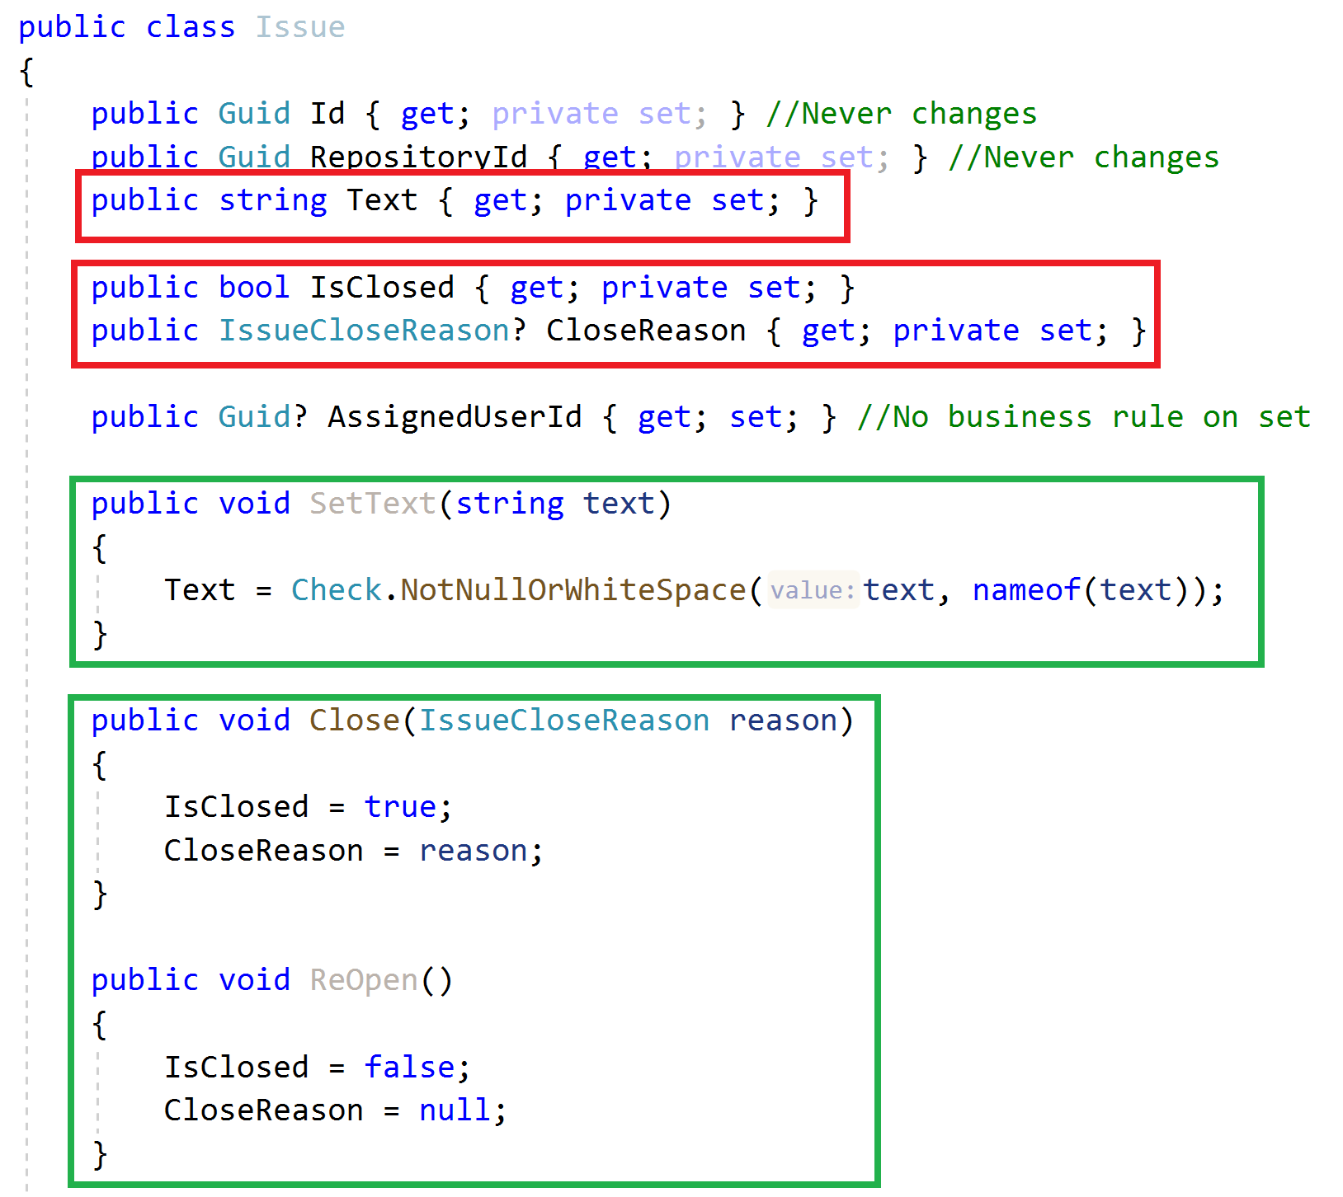
Aggregate Roots / Entities Property Accessors / Methods
Maintain object VALIDITY
Use private setters
Change properties via methods

Slide 14
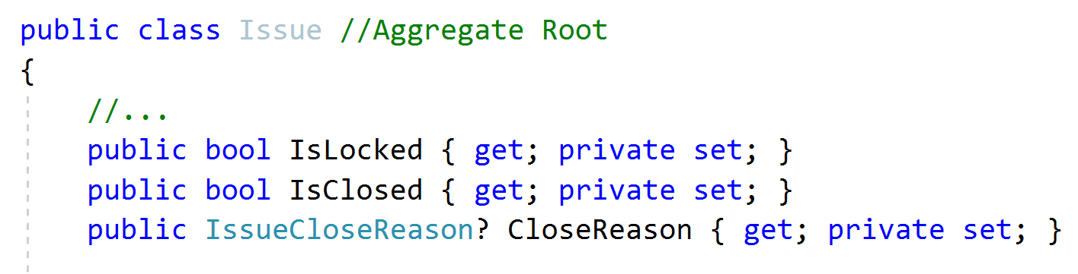
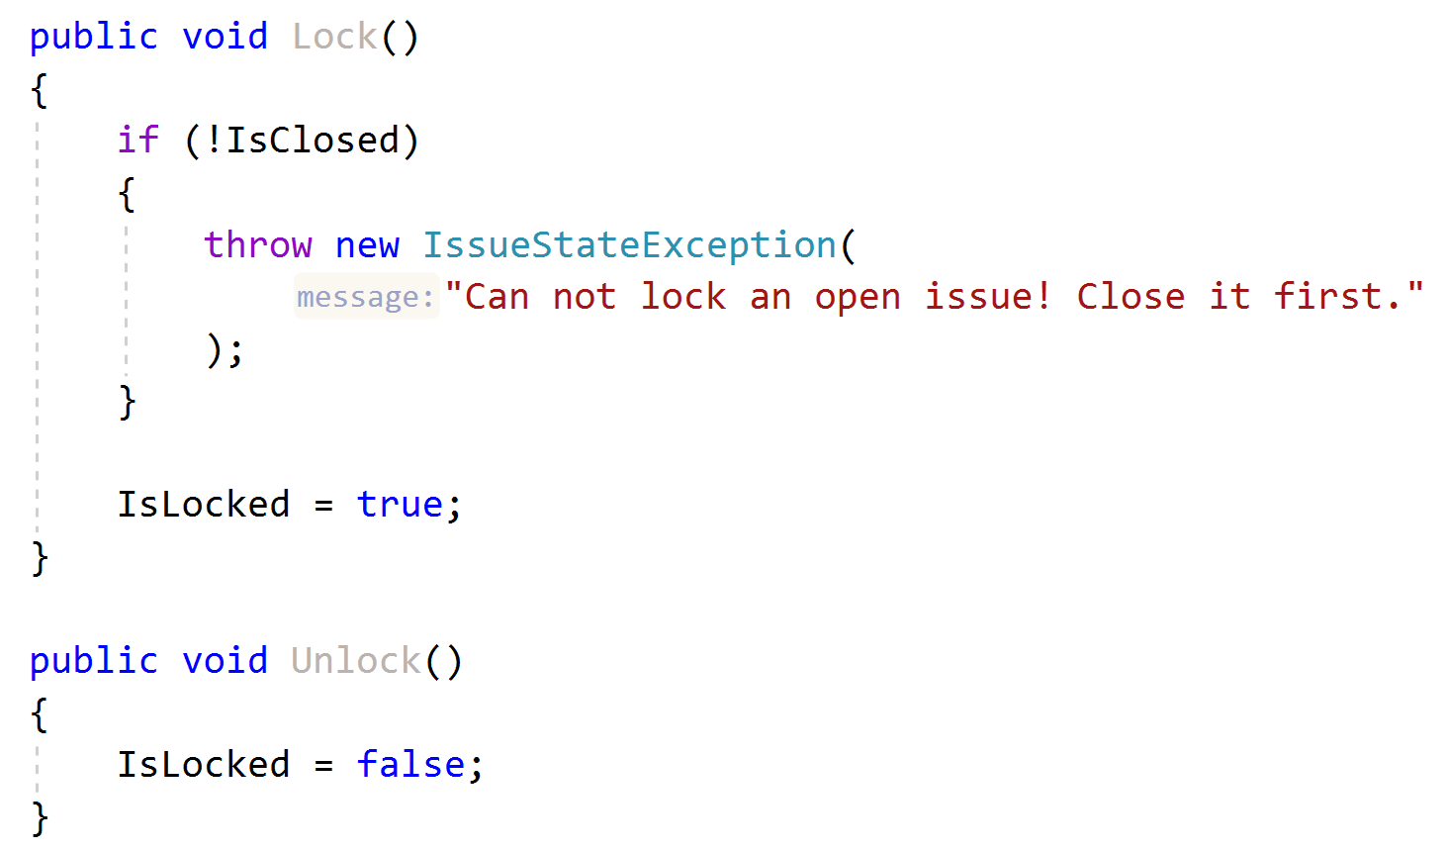
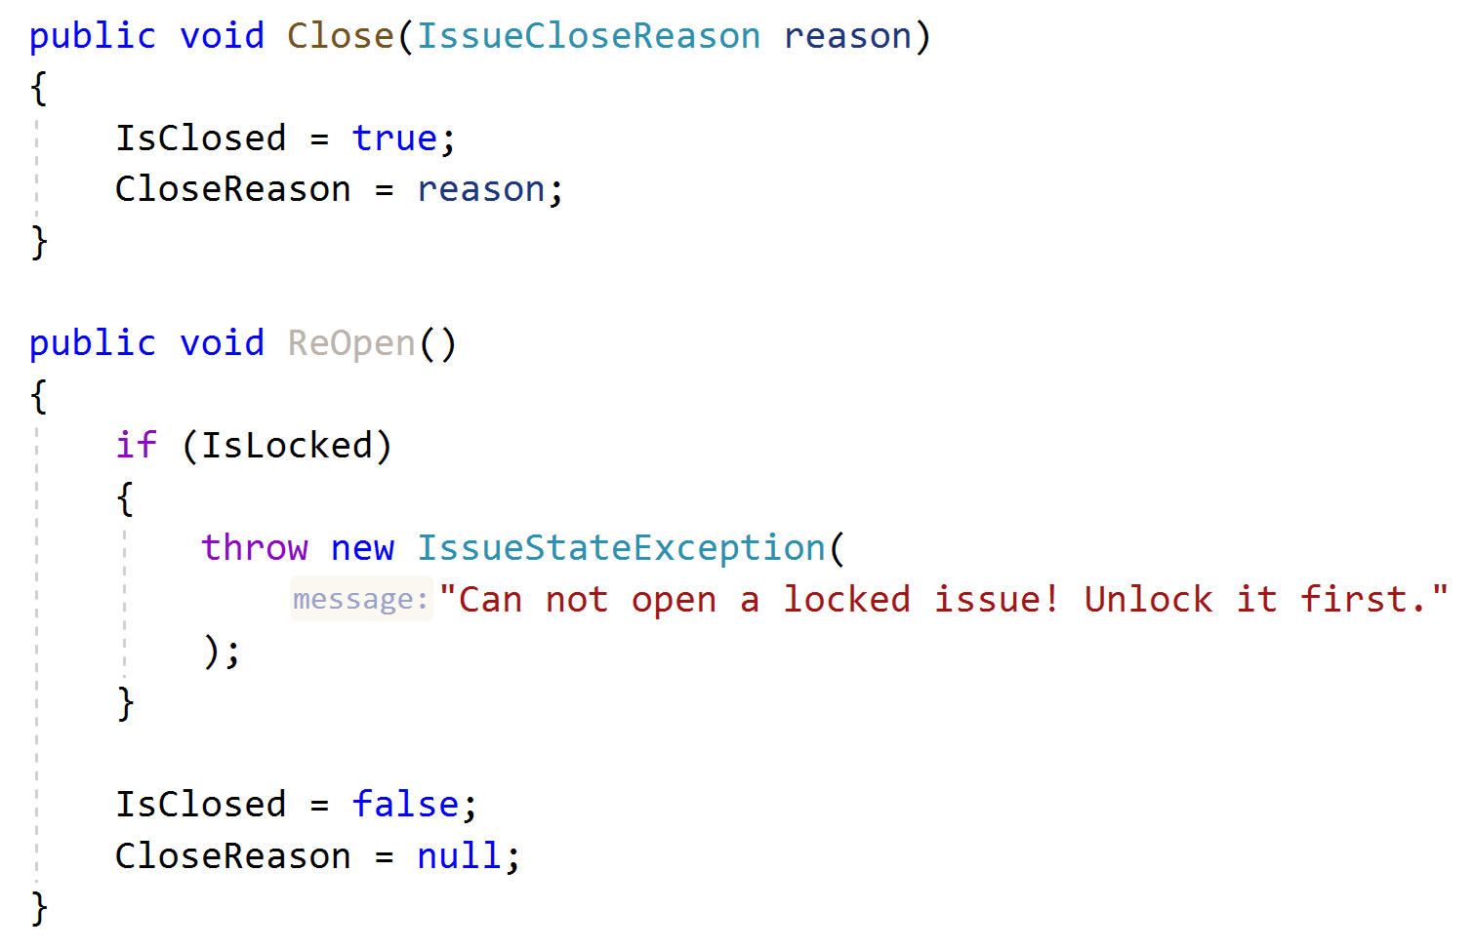
Aggregate Roots / Entities Business Logic & Exceptions
Implement Business Rules
Define a good method name matches to the domain action
Define and throw specialized exceptions

Slide 15
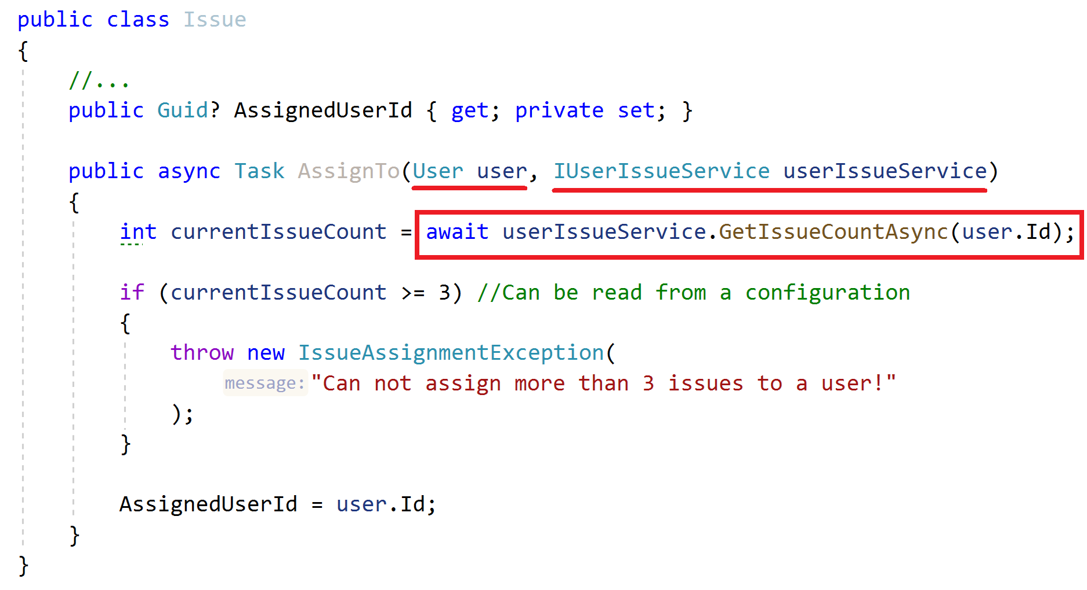
Aggregate Roots / Entities Business Logic
How to implement when you need external services?
Business Rule: Can not assign more than 3 issues to a user!

Slide 16
Aggregate Roots / Entities Business Logic
How to implement when you need external services?
Business Rule: Can not assign more than 3 issues to a user!
ALTERNATIVE..?
Create a Domain Service!

Slide 17
Repositories Principles
Define interface in the domain layer, implement in the infrastructure
Do not include domain logic
Repository interface should be database provider / ORM independent
Create repositories for aggregate roots, not entities

Slide 18
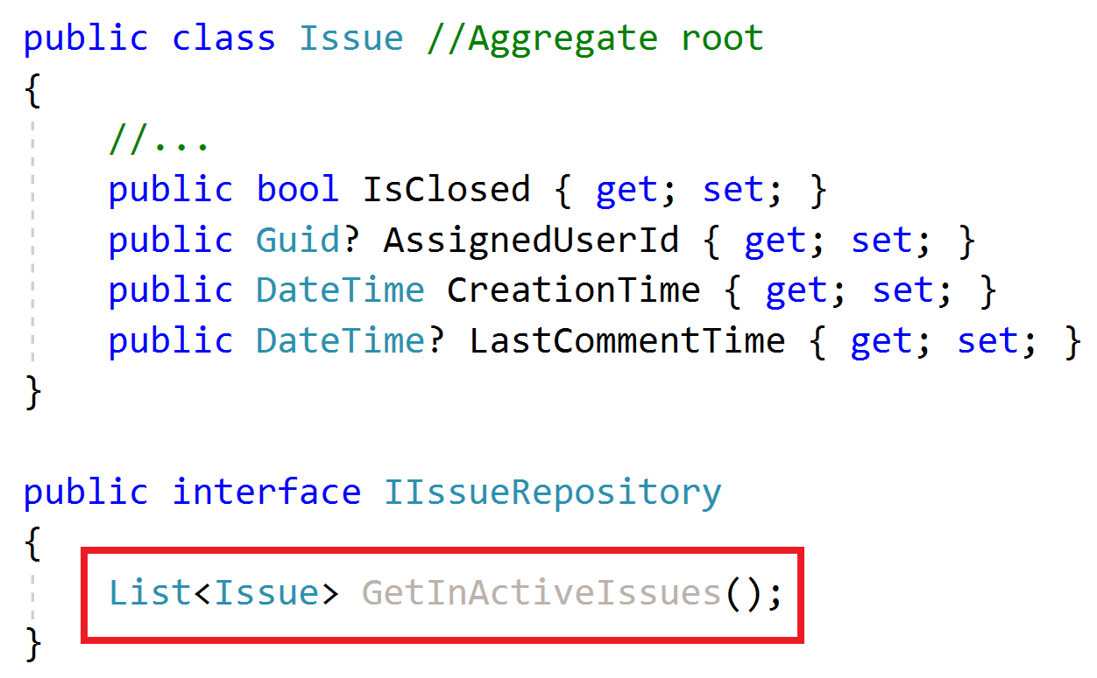
Repositories Do not include domain logic
What is an In-Active issue?

Slide 19
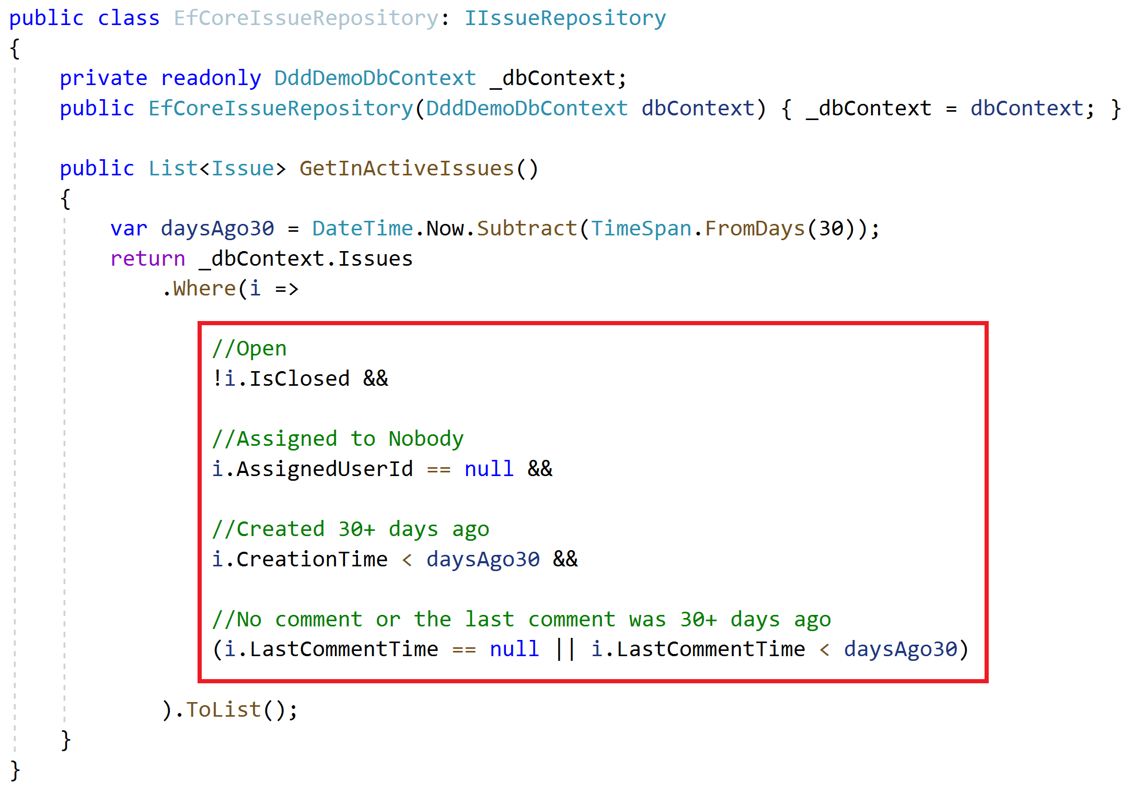
Repositories Do not include domain logic
Implicit definition of a domain rule!
How to re-use this expression? Copy/paste?

Slide 20
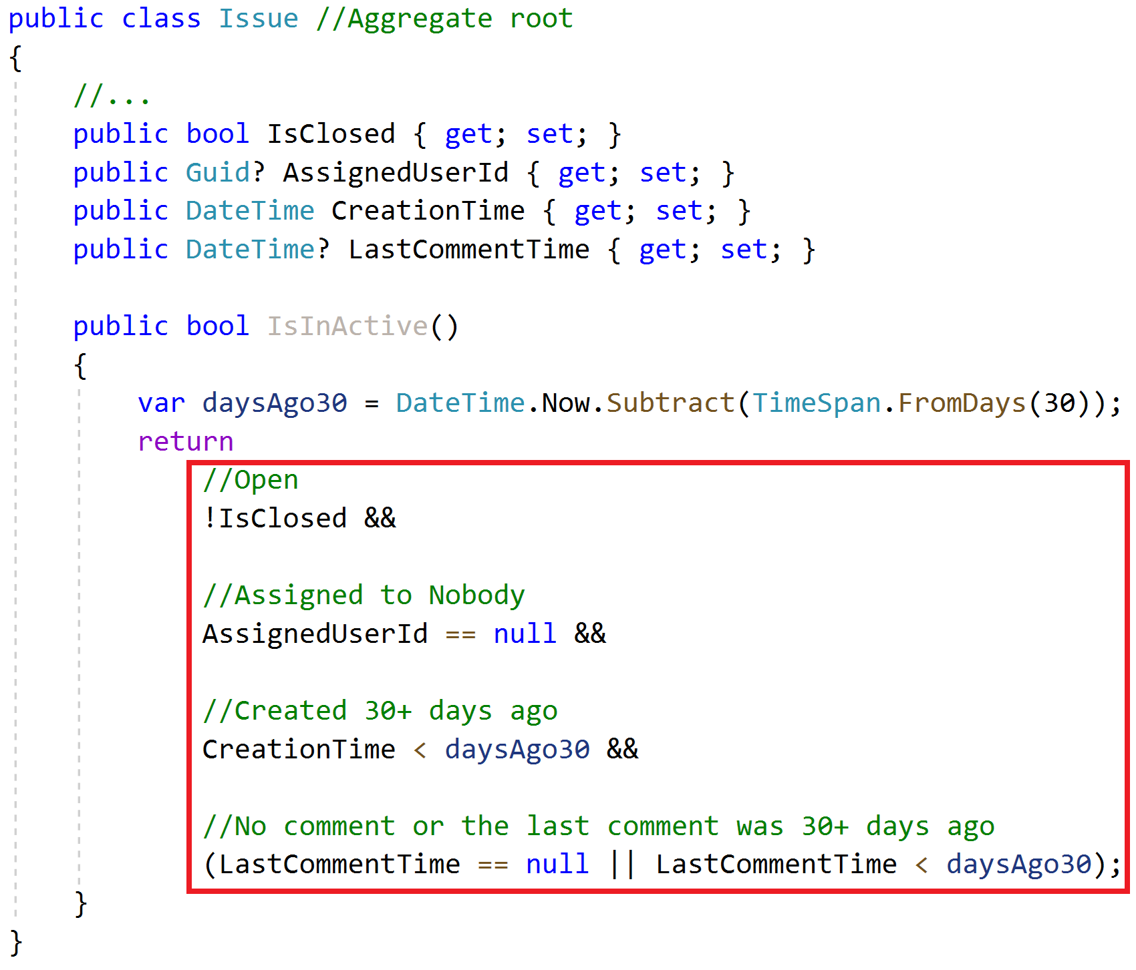
Repositories Do not include domain logic
Implicit definition of a domain rule!
How to re-use this expression? Copy/paste?
Solution: Specification Pattern! (will be explained in the next slides)

Slide 21
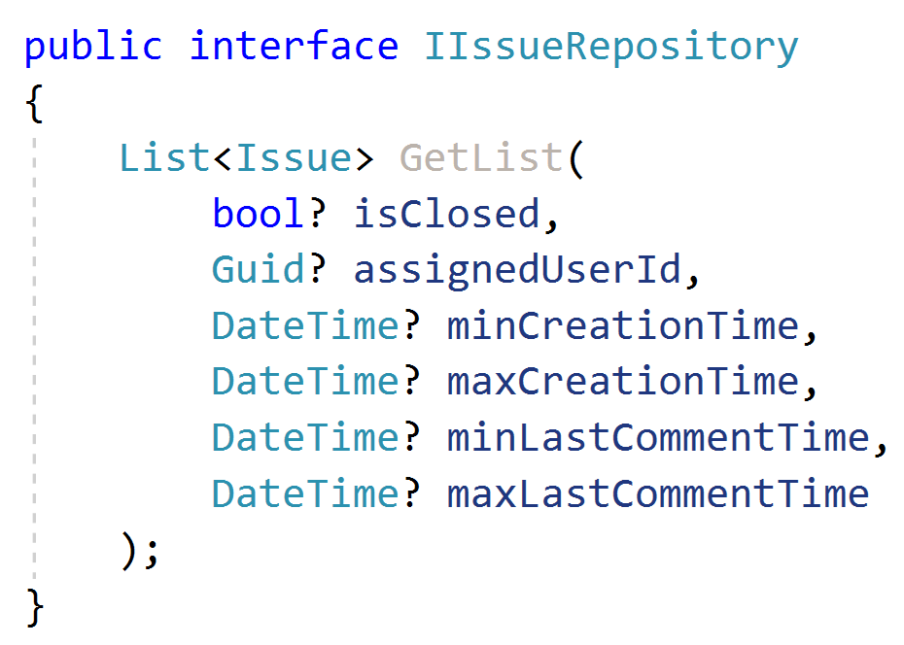
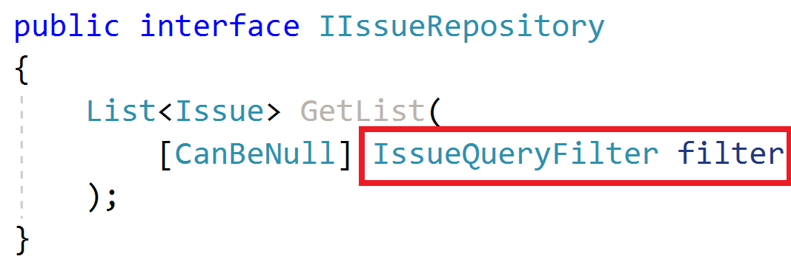
Repositories Querying

Slide 22
Repositories Querying / Read Models
Read model: A special entity-like class to read data from the database.
Minimize read models, do not use for single-entity operations
Define & use read models only in performance critical parts
TODO: Example
Do not reuse aggregate roots or entities inside read models
TODO: Example (UserWithRole, SimpleUser, DetailedUser… etc.)

